Slide 1
Network Intrusion Detection
Mini Project 2
By
Miruna Sureshkumar J

Slide 2
Problem Statement
As the technologies improve, Security becomes the biggest problem of concern.
It is really important to verify the connection if the person really is who he/she pretends to be.
The project aims at classifying such connection as either normal or an anomaly.

Slide 3
Stakeholders
Any big industry like banking and traders could be the stakeholders .
It is important to verify the identity in such money sensitive portals.
It helps improve in identifying the frauds.

Slide 4
Dataset
The Intrusion Detection System is from Kaggle.
The dataset consists of 41 features.
Some of the features are:
root_shell
num_root
protocol type
duration
num_file_creations
num_shells
num_access_files
num_outbound_cmds
is_host_login
srv_diff_host_rate
dst_host_count
dst_host_srv_count
dst_host_same_srv_rate
dst_host_srv_rerror_rate

Slide 5
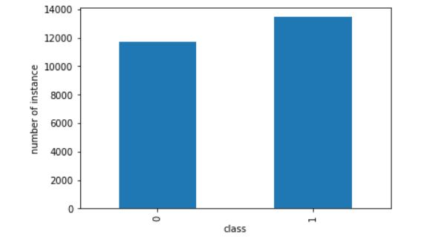
EDA
Inference : The dataset is balanced and doesn’t require resampling.

Slide 6
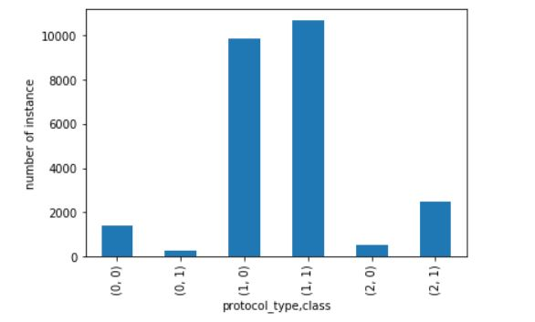
Protocol 0 is ICMP , 1 is TCP , 2 is UDP
Inference : Protocol ICMP has more anomaly than normal connection.

Slide 7
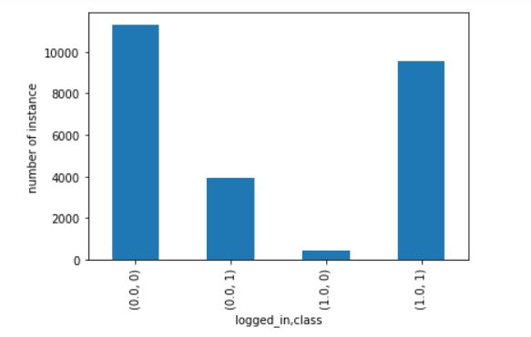
Inference : The number of anomalous requests is higher when the session has logged_in = 0

Slide 8
Feature engineering
No missing values found.
Features 'num_outbound_cmds','is_host_login‘ had all the values as zero, hence had to drop it.
Numeric columns had varying ranges. Hence used MinMax scaler to normalize the data.
Encoded the categorical data.
Selected the best features using the chi squared function values.

Slide 9
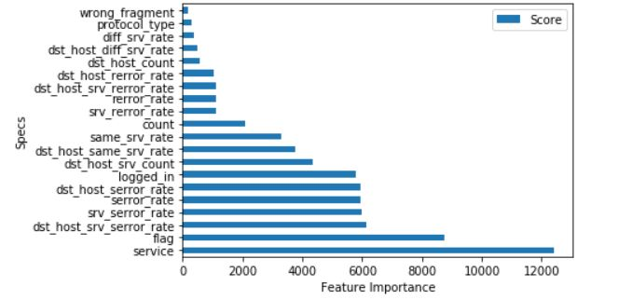
Selecting 20 best Features

Slide 10
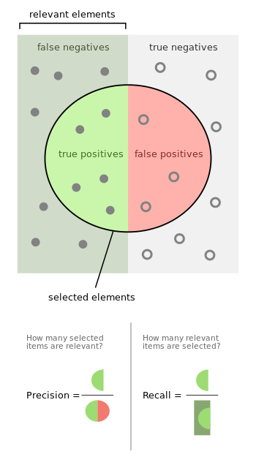
Logistic Regression
On training set
Actual/Predicted | Normal | Anomaly
Normal | 8745 | 645
Anomaly | 373 | 10390
Weighted Precision | Weighted Recall
0.95 | 0.95

Slide 11
On test set
Accuracy is 94.7%
Actual/Predicted | Normal | Anomaly
Normal | 2178 | 175
Anomaly | 92 | 2594
Weighted Precision | Weighted Recall
0.95 | 0.95

Slide 12
KNN
On training set
Actual/Predicted | Normal | Anomaly
Normal | 9293 | 97
Anomaly | 58 | 10705
Weighted Precision | Weighted Recall
0.99 | 0.99

Slide 13
On test set
Accuracy is 98.53%
Actual/Predicted | Normal | Anomaly
Normal | 2305 | 48
Anomaly | 26 | 2660
Weighted Precision | Weighted Recall
0.99 | 0.98

Slide 14
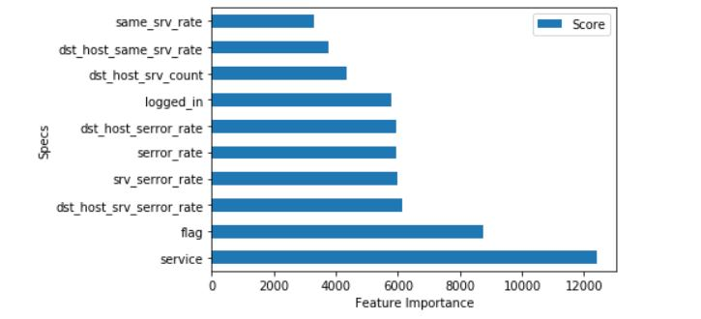
Selecting 10 best Features

Slide 15
Logistic Regression
On training set
Actual/Predicted | Normal | Anomaly
Normal | 8172 | 1218
Anomaly | 835 | 9928
Weighted Precision | Weighted Recall
0.90 | 0.90

Slide 16
On test set
Accuracy is 90%
Actual/Predicted | Normal | Anomaly
Normal | 2049 | 304
Anomaly | 195 | 2491
Weighted Precision | Weighted Recall
0.90 | 0.90

Slide 17
KNN
On training set
Actual/Predicted | Normal | Anomaly
Normal | 9192 | 198
Anomaly | 106 | 10657
Weighted Precision | Weighted Recall
0.98 | 0.98

Slide 18
On test set
Accuracy is 97.7%
Actual/Predicted | Normal | Anomaly
Normal | 2280 | 73
Anomaly | 41 | 2645
Weighted Precision | Weighted Recall
0.98 | 0.98

Slide 19
Inference
By eliminating too many features we tend to lose some important information.
The model developed thus under fits, and the accuracy tends to drop down.

Slide 20

Thank you!!

